Slide 1
Use case diagram

Slide 2


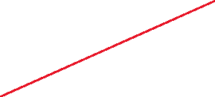
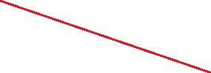



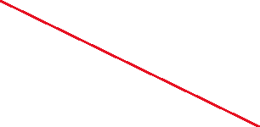
Subsystem : user
Search for the workout
Search by limit to location
Book a slot with time and location
Selection from history
Register if you need a trainer
Book slot for future dates
User
Set reminders for booked slots
Select to workout with a group or induvidually
View pictures of selected place
Cancel the booking

Slide 3
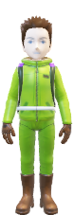
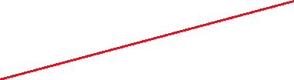


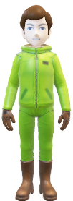

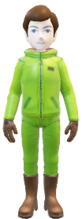
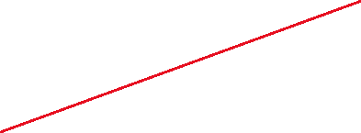



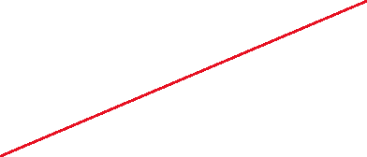


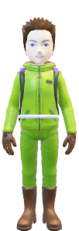
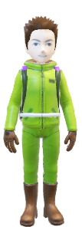







Lets get fit!
Subsystem: all actors
Selection from history
Register for Trainer requirement
Book slots for future dates
Search by location limit
User
View pictures of selected place
Database team
Select for team training
Tag a user
register for Individual training
Register for group training
Team member
Allocate slots and prepare schedule
Update user information
Update time and slot info
Support team
Registrar
Address user queries
Download rules and regulations

